Slide 1

Module 1
Introduction
Notes:
Guidelines
Use section headers to chunk content in your presentation.
Use the same style of section header throughout your presentation.
Keep your title to no more than 2 lines.

Slide 2
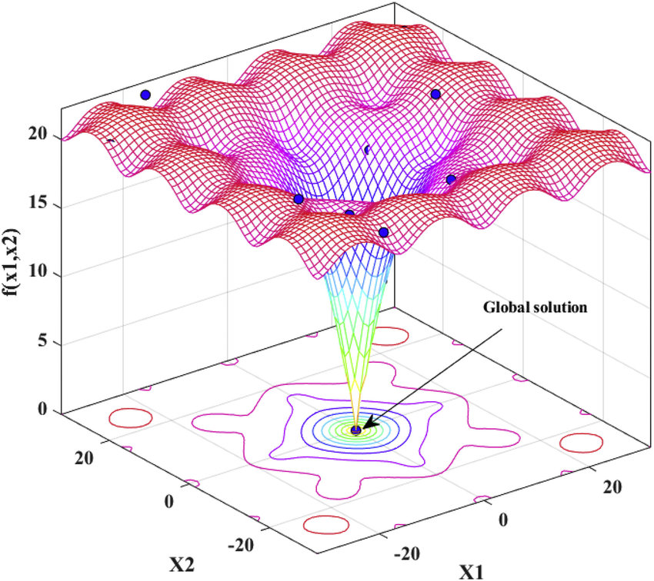



Cost Function in LR
$$J(w)$$
$$w_{0}$$
$$w_{1}$$
Notes:
Guidelines
Use a title slide at the beginning of your presentation. There are 9 variations of title slides to choose from.
If you will have a series of slideshows, we recommend using the same style of title slide for each presentation.
Keep your title to no more than 2 lines.
Do not change the font style or font size of the title or subtitle.

Slide 3
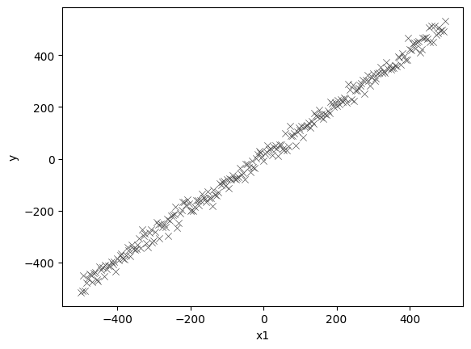

Example: Convex Cost Function
Assume there is a unknown function $f:X \underset{→}{maps}y$
Assume a linear estimator (hypothesis) $h:X \underset{→}{maps}y$ works well

Slide 4
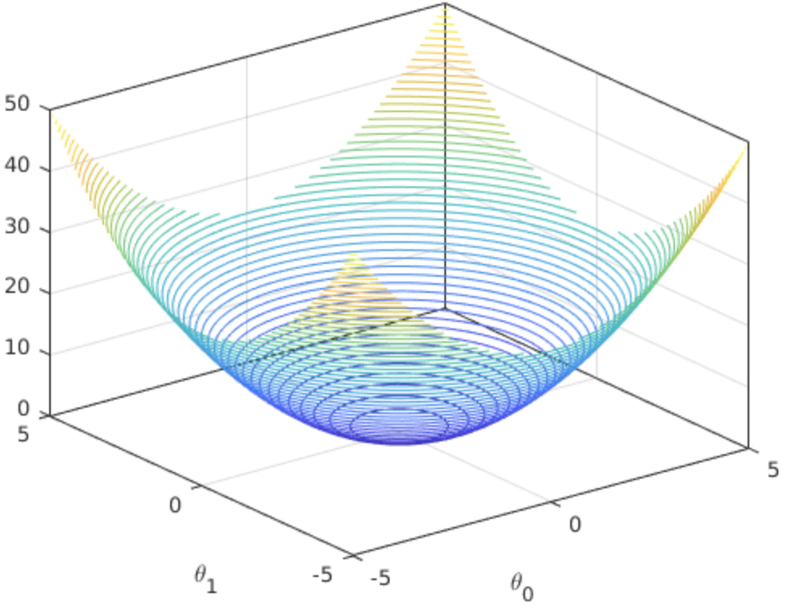




Example: Convex Cost Function
Assume there is a unknown function $f:X \underset{→}{maps}y$
Assume a linear estimator (hypothesis) $h:X \underset{→}{maps}y$ works well
If $h$ is linear regression, then cost function SSE is convex
$$J(w_{0},w_{1})$$
Global minimum
$$w_{0}$$
$$w_{1}$$

Slide 5
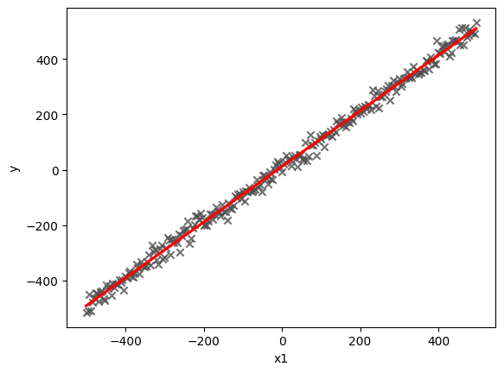


Example: Convex Cost Function
We can find the parameter vector $w=[w_{0}, w_{1}]$ minimizing SSE
We do need to create a design matrix $X=[1 x_{1}]$
The model predictions would be: $h_{w}(X)=$ $X$ $w$
$X$ $w$
$X$ $w$

Slide 6
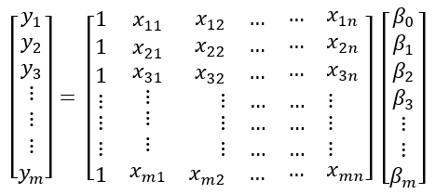


Example: Convex Cost Function
We can find the parameter vector $w=[w_{0}, w_{1}]$ minimizing SSE
We do need to create a design matrix $X=[1 x_{1}]$
The model predictions would be: $h_{w}(X)=$ $X$ $w$
Bias or Intercept
features
$$+ε$$
1) Create y vector
2) Create X Matrix (also Called the Design/Model Matrix)

Slide 7
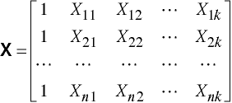


Example: Convex Cost Function
We can find the parameter vector $w=[w_{0}, w_{1}]$ minimizing SSE
We do need to create a design matrix $X=[1 x_{1}]$
The model predictions would be: $h_{w}(X)=$ $X$ $w$
$$w=\left[\begin{matrix}w_{0} \\ w_{1} \\ \begin{aligned}⋮ \\ w_{k}\end{aligned}\end{matrix}\right]$$

Slide 8
Python
Notes:
Guidelines
Use a title slide at the beginning of your presentation. There are 9 variations of title slides to choose from.
If you will have a series of slideshows, we recommend using the same style of title slide for each presentation.
Keep your title to no more than 2 lines.
Do not change the font style or font size of the title or subtitle.

Slide 9



Example: Convex Cost Function
Cost function is SSE
$$J\left(w\right)={\left(y−Xw\right)}^{⊤}\left(y−Xw\right)={\left\|y−Xw\right\|}_{2}^{2}$$
$$J(w)$$
Global minimum
$$w_{0}$$
$$w_{1}$$

Slide 10
Python
Notes:
Guidelines
Use a title slide at the beginning of your presentation. There are 9 variations of title slides to choose from.
If you will have a series of slideshows, we recommend using the same style of title slide for each presentation.
Keep your title to no more than 2 lines.
Do not change the font style or font size of the title or subtitle.

Slide 11
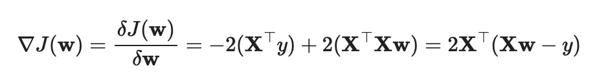
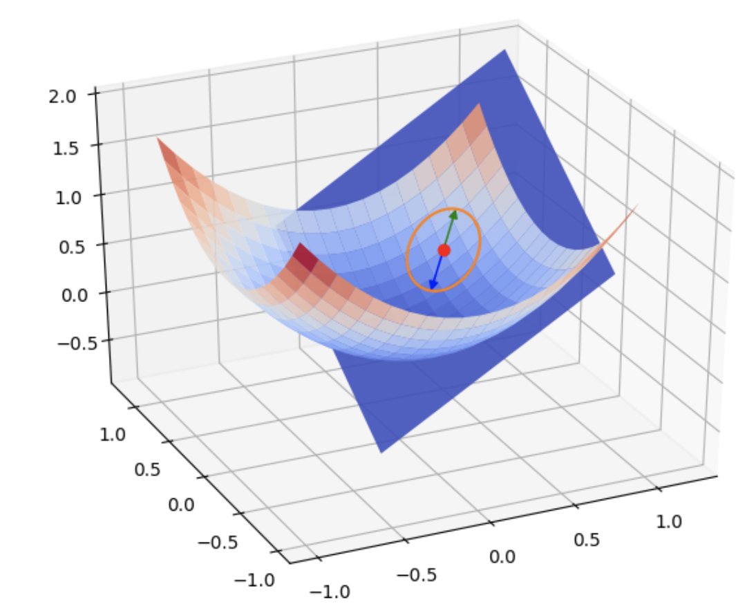
Example: Convex Cost Function
Gradient is the derivative of the cost function WRT parameters.

Slide 12
Python
Notes:
Guidelines
Use a title slide at the beginning of your presentation. There are 9 variations of title slides to choose from.
If you will have a series of slideshows, we recommend using the same style of title slide for each presentation.
Keep your title to no more than 2 lines.
Do not change the font style or font size of the title or subtitle.

Slide 13



Example: Convex Cost Function
Setting the gradient to zero and solving for $w$ gets solution for min.
Set to zero and solve for $w$
$$w={\left(X^{⊤}X\right)}^{−1}(X^{⊤}y)$$
$$J(w)$$
Global minimum
$$w_{0}$$
$$w_{1}$$

Slide 14
Python
Notes:
Guidelines
Use a title slide at the beginning of your presentation. There are 9 variations of title slides to choose from.
If you will have a series of slideshows, we recommend using the same style of title slide for each presentation.
Keep your title to no more than 2 lines.
Do not change the font style or font size of the title or subtitle.

